Slide 1
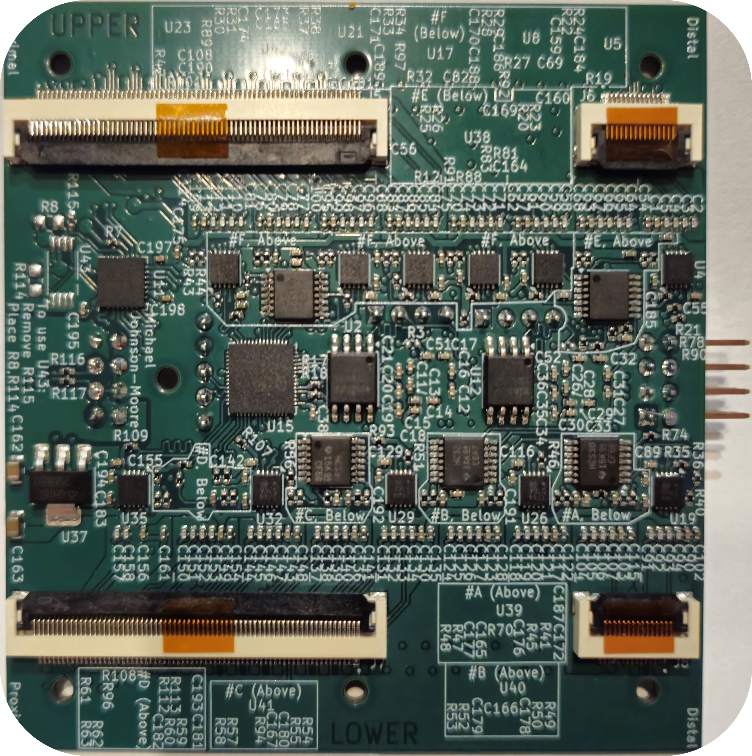
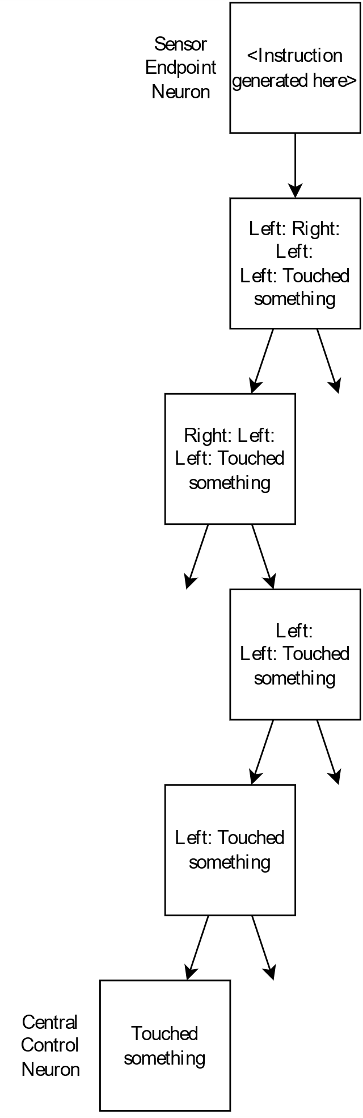
Experimentation in control and communication methods for neuron-based adaptable robotics Michael Johnson-Moore, student (Electronics and Computer Engineering Technology) Faculty Advisor: Dr. Iftekhar Basith, Department of Engineering Technology Presented at 2025 Undergraduate Research Symposium, hosted by Elliot T. Bowers Honors College at Sam Houston State University.
Abstract
Software Information
Back of Circuit Board
This project involved the creation of a custom circuit board set and assembly for a robotic arm based on a physical neural network architecture. The primary design goal of the arm is to be adaptable to changing geometry, using machine learning to allow the arm to complete its operator’s given objective while maintaining safety. The arm is covered in capacitive and inductive sensors in order to detect impending collisions and automatically redirect its movement path to avoid them. In addition to constructing the arm, this project involves experimenting with various methods of communication and control. While the arm is idle, it will slowly scan its area to determine its maximum operational range.
From a logical standpoint, the software and firmware are organized into simple, logical neurons, which receive input data, manipulate it, and write outputs to adjacent neurons. The neurons are arranged in a tree from a central controller. The software organization plan for this project includes 5 types of neurons:
1. Central controller
This neuron interfaces between the robot and the operator or outside world. It is responsible for planning the arm’s movement path, learning the arm’s geometry and environment, issuing commands to joints, and receiving and analyzing sensor data.
2. Communication neuron
This neuron type takes input data and passes it to its output, possibly with intermediate calculations. All neurons are specialized versions of these.
3. Sensor endpoint neuron
These neurons manage sensors outside the neuron network, convert the readings to network-compatible data, and pass it to the communication backbone.
4. Reflex processor neuron
These neurons respond to sensor data faster than the central controller, and can override joint commands to prevent collisions.
5. Joint Actuation neuron
These move joints.
As of printing this poster, the firmware for the circuit boards is still a work in progress. In addition to the physical arm, this project includes a simulator, which is also a work in progress.
Purpose and Process
The project was initially planned conceptually. Seven communication methods were considered, with four-five of them planned to be tried (1-5, below). The initial hardware was planned to be more modular but was partially centralized to minimize cost. Most components were selected to be cheap while providing sufficient pins for the design goals; some were selected for board size or modular butfor oversights while minimizing needed design changes.
The hardware was designed before the software, as it needs time to be manufactured. During project planning, the circuit board design phase was allocated 3 weeks, but it took 4 ½ months. As a result, this project is significantly behind, and at this point, it is not possible to complete it to the original goals.
Original Goals
The robotic arm was intended to: adapt to changes in its geometry when modular segments are attached or removed; scan through its environment while idle to detect obstacles and safely avoid collisions; automatically direct its movement path based on the learned data; and provide a platform for experimenting with various methods of control and communication. This project was performed to provide the researcher experience working in artificial neural network design, robotics, and electronic consumer device design, as well as providing a start of research into smart prosthetics and body enhancement.
The seven original communication methods were as follows:
1. Traditional networking based on power substation networking, using IP addressing, GOOSE, and DNP3.
2. Onion-tree routing as shown in Figure 1.
3. Input modification as scalar combinatorial arithmetic, where each neuron (see Software Information, right) calculates its output values as a mathematical function of its input values.
4. Input modification as vector combinatorial arithmetic, which combines 2 and 3 by rotating the inputs in addition to scaling them, potentially improving accuracy.
5. Input modification as a neuron subset of a machine learning AI. This method was considered a “maybe check, depending on time.”
6. Input modification as an individual machine learning neural
Hardware Information
The hardware consists of 3-inch cylindrical segments which plug into each other to build a rigid limb of arbitrary length (length must be a multiple of 3 inches). Each segment uses 3 microcontrollers, to have enough communication channels to interface with the sensors, of which there are 132.
The Raspberry Pi RP2040 microcontroller, used in their Pico product, was chosen for its low price point and fairly large number of programmable I/O pins for connecting to the sensor controllers.
Two very common sensor types are inductive and capacitive sensors. Inductive sensors have a longer range, but only detect metal. Capacitive sensors have a short range, but can detect people or other objects. Cellphone touch screens usually use [higher quality] capacitive sensors. Not knowing which would work best for this project, both are used, checkerboarded on the sensor boards (not shown on this poster).
The original circuit boards featured 5 sensors, so the Microchip CAP1206 controller was chosen, which has channels for 6 sensors. There is a 14 sensor variant which would’ve worked better, but the researcher neglected to look into higher channel options when switching to the larger boards.
Inductive sensor controllers proved to be uncommon and hard to find good options for, so the Texas Instruments LDC3114 was selected, which supports 4 channels with distance data. These are available in a smaller package, but the smaller package option is below the manufacturing capabilities of the chosen board manufacturer.
Rather than spend the cost and space of three separate USB ports for each RP2040, a USB Hub was used, with a switch to indicate to the RP2040s that they are being programmed.
The modules are designed to accept 5 to 16 Volts at a maximum of 6 amps of input power, for flexibility in assembly. If a large arm is being used, it’s recommended to use a higher voltage.
Due to time constraints, a custom circuit board for the joints was not made; they were hand-assembled using soldered breadboards and pre-built circuit modules.
References
D. Hou and D. Dolezilek, “IEC 61850 – what it can and cannot offer to traditional protection schemes,” SEL Journal of Reliable Power, vol. 1, no. 2, Oct. 2010. [Online]. Available: https://cdn.selinc.com/assets/Literature/Publications/Technical%20Papers/6335_IEC61850_DH-DD_20080912_Web.pdf
R. Lent, F. A. C. Azevedo, C. H. Andrade-Moraes, and A. V. O. Pinto, “How many neurons do you have? some dogmas of quantitative neuroscience under revision,” European Journal of Neuroscience, vol. 35, no. 1, pp. 1–9, 2012. [Online]. Available: https://onlinelibrary.wiley.com/doi/abs/10.1111/j.1460-9568.2011.07923.x
M. Islam, G. Chen, and S. Jin, “An overview of neural network,” American Journal of Neural Networks and Applications, vol. 5, no. 1, pp. 7–11, 2019. [Online]. Available: https://doi.org/10.11648/j.ajnna.20190501.12
(2021, Aug.) Inductive sensing design calculator tool. Texas Instruments. [Online]. Available: https://www.ti.com/tool/download/ LDC-CALCULATOR-TOOLS
RP2040 Datasheet: A microcontroller by Raspberry Pi, eec2b0cclean ed., Raspberry Pi, Oct. 2024. [Online]. Available: https://datasheets.raspberrypi.com/rp2040/rp2040-datasheet.pdf
Raspberry Pi Pico Pinout, Raspberry Pi. [Online]. Available: https://datasheets.raspberrypi.com/pico/Pico-R3-A4-Pinout.pdf
Hardware design with RP2040: Using RP2040 microcontrollers to build boards and products, 2nd ed., Raspberry Pi, Oct. 2024. [Online]. Available: https://datasheets.raspberrypi.com/rp2040/hardware-design-with-rp2040.pdf
spiflash® 3V 128M-BIT SERIAL FLASH MEMORY WITH DUAL/QUAD SPI & QPI & DTR, C ed., winbond, Mar.2018. [Online]. Available: https://www.winbond.com/resource-files/w25q128jv_dtr%20revc%2003272018%20plus.pdf
1.0 A Low-Dropout Positive Fixed and Adjustable Voltage Regulators NCP1117, NCP1117I, NCV1117, 31st ed., onsemi, Aug. 2021. [Online]. Available: http://www.onsemi.com/pub_link/Collateral/NCP1117-D.PDF
CAP1206: 6-Channel Capacitive Touch Sensor, DS00001567B ed., Microchip Technology, Nov. 2015. [Online]. Available: https://www.microchip.com/en-us/product/cap1206
LDC3114 4-Channel Hybrid Inductive Touch and Inductance to Digital Converter, 1st ed., Texas Instruments, Dec. 2021. [Online]. Available: https://www.ti.com/lit/ds/symlink/ldc3114.pdf
LDC2112, LDC2114 Inductive Touch Solution for Low-Power HMI Button Applications, B ed., Texas Instruments, Jan. 2017. [Online]. Available: https://www.ti.com/lit/ds/symlink/ldc2114.pdf
SN5430, SN54LS30, SN54S30, SN7430, SN74LS30, SN74S30, 8-Input Positive-NAND Gates, Texas Instruments, Mar. 1988. [Online]. Available: https://www.ti.com/lit/ds/symlink/sn74ls30.pdf
SN5432, SN54LS32, SN54S32, SN7432, SN74LS32, SN74S32, Quadruple 2-Input Positive-OR Gates, Texas Instruments, Mar. 1988. [Online]. Available: https://www.ti.com/lit/ds/symlink/sn74ls32.pdf
CY7C65632, CY7C65634: HX2VL - Very Low-Power USB 2.0 Hub Controller, O ed., infineon, Oct. 2024. [Online]. Available: https://www.infineon.com/dgdl/Infineon-CY7C65632_CY7C65634_HX2VL_VERY_LOW-POWER_USB_2.0_HUB_CONTROLLER-DataSheet-v14_00-EN.pdf?fileId=8ac78c8c7d0d8da4017d0ecd35994769&utm_source=cypress&utm_medium=referral&utm_campaign=202110_globe_en_all_integration-files&redirId=File_1_1_521
Data sheet: FR202xxHBDN, W ed., Metz Connect, Dec. 2024. [Online]. Available: https://media.metz-connect.com/files/171/Data_sheet_FR202XXHBDN.PDF
Data sheet: PR202xxHBDN, W ed., Metz Connect, Dec. 2024. [Online]. Available: https://media.metz-connect.com/files/171/Data_sheet_PR202XXHBDN.PDF
Figure 1. Example of Onion-Routing
network per software neuron. This method was considered a “will not check,” due to using cheap low-power microcontrollers.
7. Simulation of an actual biological neuron. This method is strongly desired by the researcher, but is beyond his knowledge and skills at this time. For this reason, this method is “will not check,” and is listed as a potential goal for a future project based on this project.
Thanks and Acknowledgements
· Elliot T. Bowers Honors College For providing $600 Research Funding.
· ASEE Manufacturing Division For providing $1000 Travel Grant.
· Dr. Iftekhar Basith For acting as faculty advisor on this project.
· Dean Kimberly Bell For allowing this thesis project.
· American Society for Engineering Education For accepting paper for presentation at their 2025 conference in Montreal, Canada.

